Slide 1
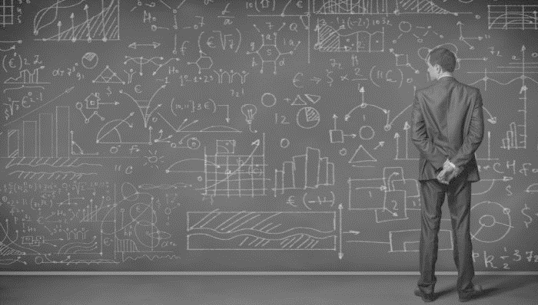
DATA SCIENCE
Clustering

Slide 2
Unsupervised Learning
Clustering – K-Means/Hierarchical
Association Rules

Slide 3
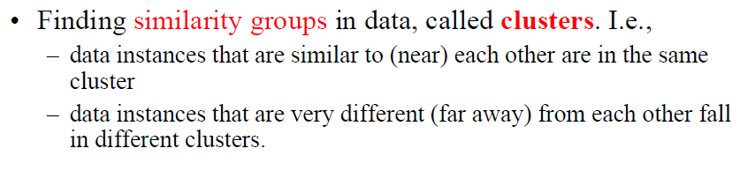
Clustering

Slide 4
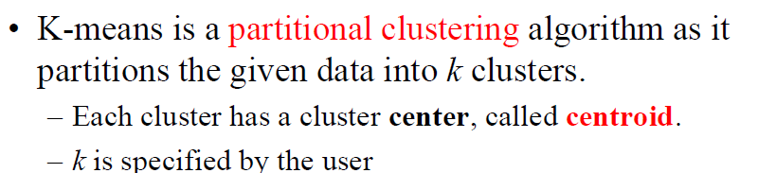
K-Means Clustering

Slide 5
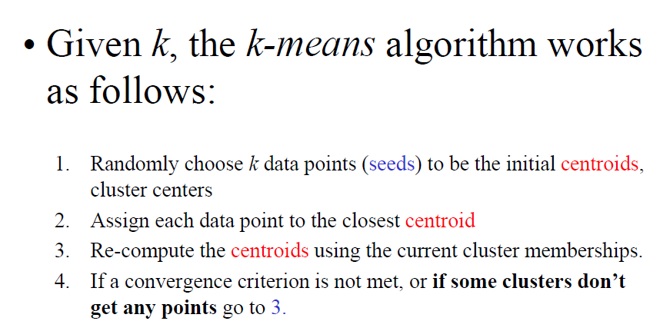
K-Means Clustering

Slide 6
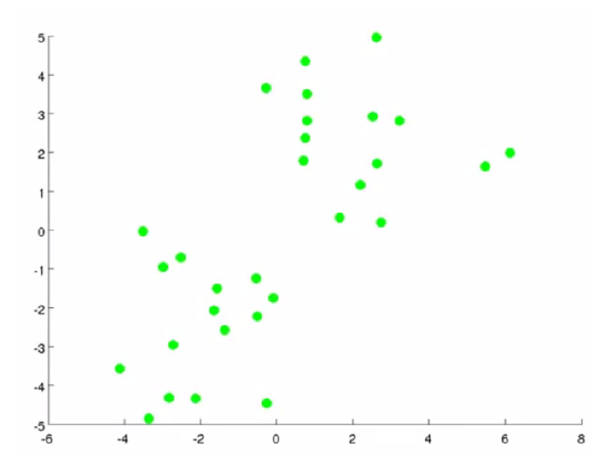

Slide 7
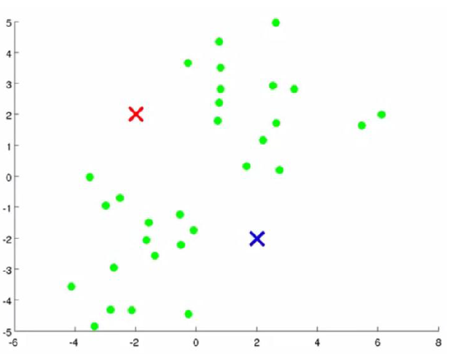

Slide 8
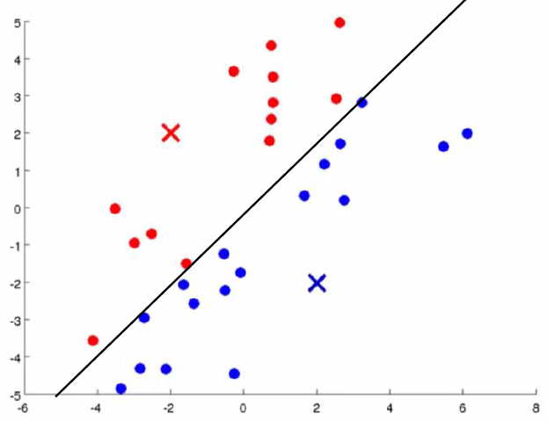

Slide 9
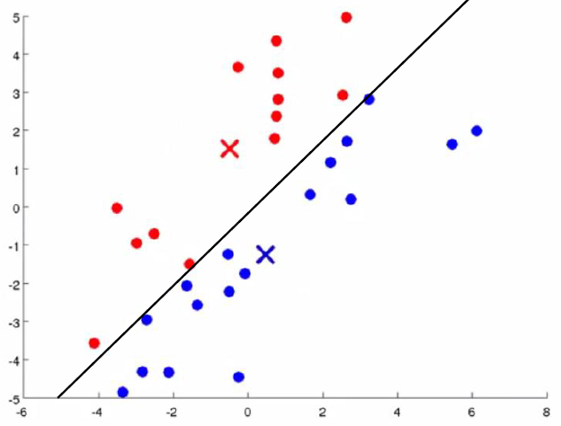

Slide 10
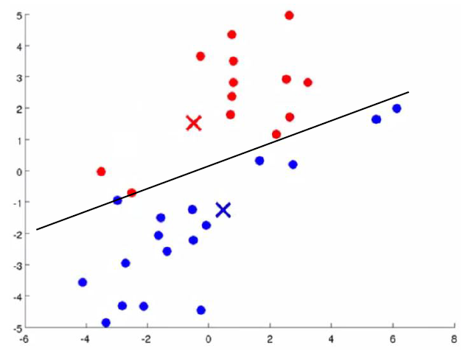

Slide 11
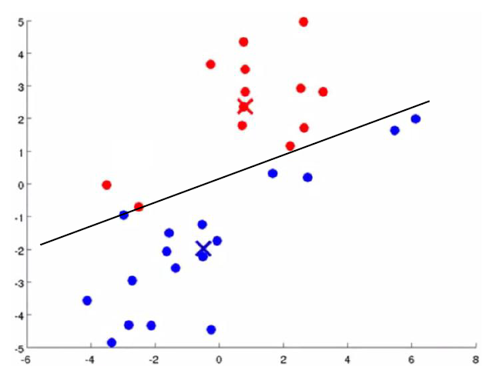

Slide 12
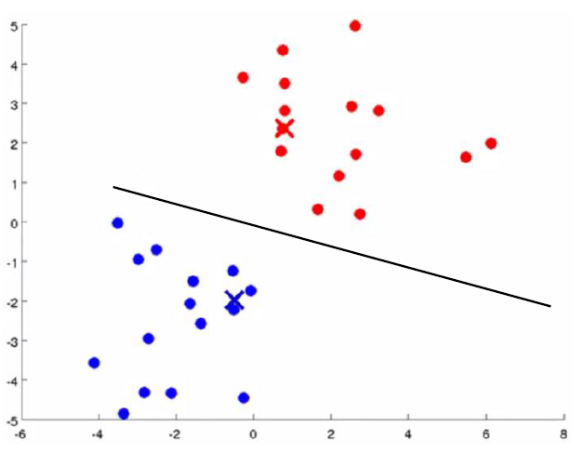

Slide 13
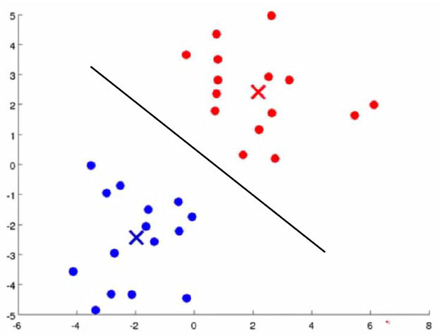

Slide 14
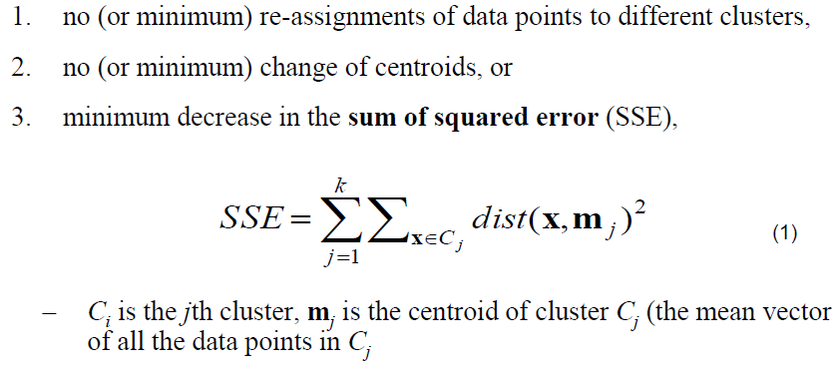
Stopping Criterion

Slide 15
K-Means Clustering
Maximise Inter-Cluster Distance
Minimise Intra-Cluster Distance

Slide 16


Slide 17

Let’s

